Slide 1
The USGS Resource for Advanced Modeling:
Developing an operational capacity
USGS (Morisette, PI)
Montana State University (Hansen, PI)
NASA Biodiversity Team meeting
1
Notes:
Student presentation/poster judge
Attending interdisciplinary session on art and science
Explain ReVAMP
Alternate title: “What happened to the promise of NASA’s Earth Observing System?: are we fully utilizing remote sensing products for climate science?”
Your not the director of USGS and Paul’s not the director of DEVELOP?
There will be an oral session (Wed morning G31l and poster session G33E.

Slide 2
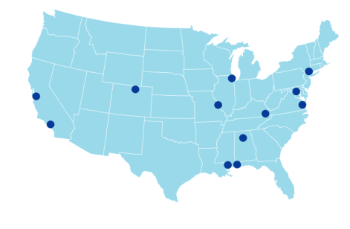
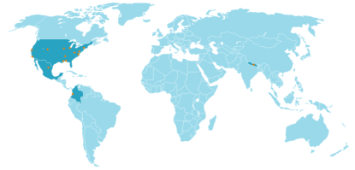
USGS team
Catherine Jarnevich
Tracy Holcombe
Colin Talbert
Marian Talbert
USGS-CSU
Resource for
Advanced Modeling
Sunil Kumar
Cam Aldridge
Tom Stohlgren
Dennis Ojima
Tom Hilinski
David Koop
Claudio Silva
Denis Ojima
Andy Hansen
Joe Barsugli
David Blodgett
Emily Fort
Robin O’Malley
Shawn Carter
Doug Beard
Petr Votava
Rama Nemani
Paul Evangelista
2

Slide 3
MSU team
Using NASA Resources to Inform Climate and Land Use Adaptation
Andy Hansen, Montana State University
Scott Goetz, Woods Hole Research Center
Bill Monahan & John Gross, NPS I&M Program
Forrest Melton & Rama Nemani, CSU Monterey Bay / NASA Ames
Tom Olliff, NPS and Great Northern LCC
Dave Theobald, Colorado State University
NASA Applied Sciences Program
(NNH10ZDA001N - BIOCLIM)
NPS I&M Program
3

Slide 4
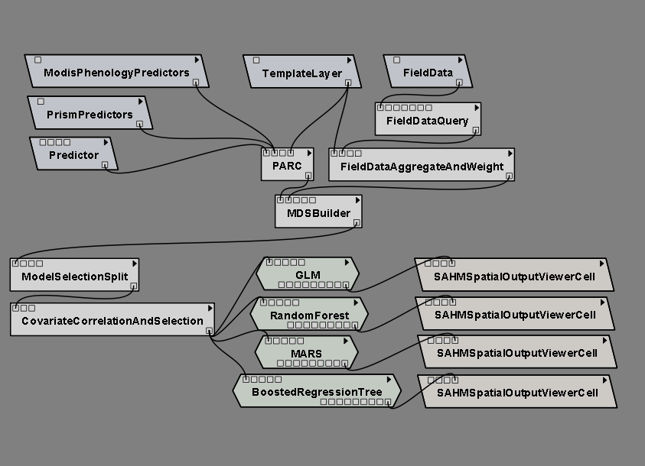
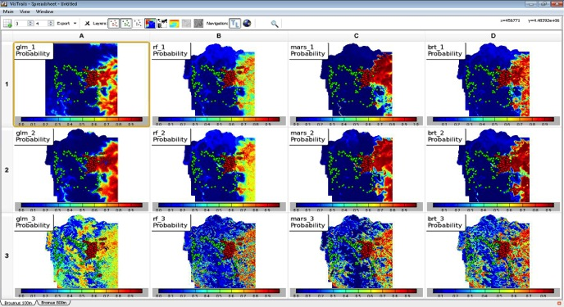
VisTrails SAHM: visualization and workflow management for species habitat modeling
Research product
Initial paper to introduce the “Software for Assisted Habitat Modeling (SAHM).
Specific modules in SAHM to incorporate MODIS products.
Open access: Full details of the VisTrails:SAHM package and tutorial are given at
https://my.usgs.gov/catalog/RAM/SAHM
Morisette et al., 2013. VisTrails SAHM: visualization and workflow management for species habitat modeling. Ecography 36: 129–135. doi: 10.1111/j.1600-0587.2012.07815.x

Slide 5
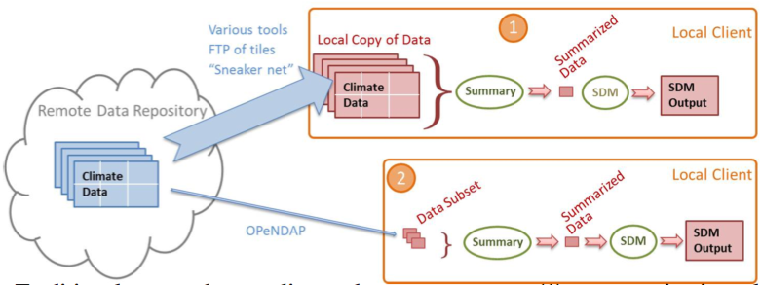
Data Management Challenges in Species Distribution Modeling
Research product
Describing the computational challenges in climate-data driven species distribution modeling and solutions using scientific workflow systems.
Where we are.
Where we’re going.
Talbert, C., M. Talbert, J. Morisette, D. Koop. 2013. Data Management Challenges in Species Distribution Modeling. IEEE Data Eng. Bull. 36(4)31-40, http://sites.computer.org/debull/A13dec/p31.pdf.

Slide 6
Operational Capacity
Research product
VisTrails:SAHM training every six months (next training, fall 2014)
VisTrails:SAHM being used for
MSU and Greater Yellowstone Coordinating Committee work on White Bark Pine Habitat under climate change.
MSU modeling of 8 tree species in the Greater Yellowstone Area
Colorado Natural Heritage Program’s work with Colorado’s State Wildlife Action Plan
CSU/USGS work on migratory bird habitat models in the Plains and Prairie Pothole region
CSU work on Fruit Fly habitat
Others not directly working with our group
VisTrails will be used for operationalizing “Climate Primer” graphics and climate summaries.
Exploring machine services data access to USGS’s GeoDataPortal (climate) and NASA’s LP DAAC (satellite products)

Slide 7
Lessons learned
From Gross, Hansen, Goetz, Theobald, Melton, Piekielek, Nemani. 2012. Remote sensing for inventory and monitoring of the U.S. National Parks. Pages 29-56 in: Remote Sensing of Protected Areas
Allocate time to develop a genuine science-management partnership
Communicate results in a management-relevant context

Slide 8
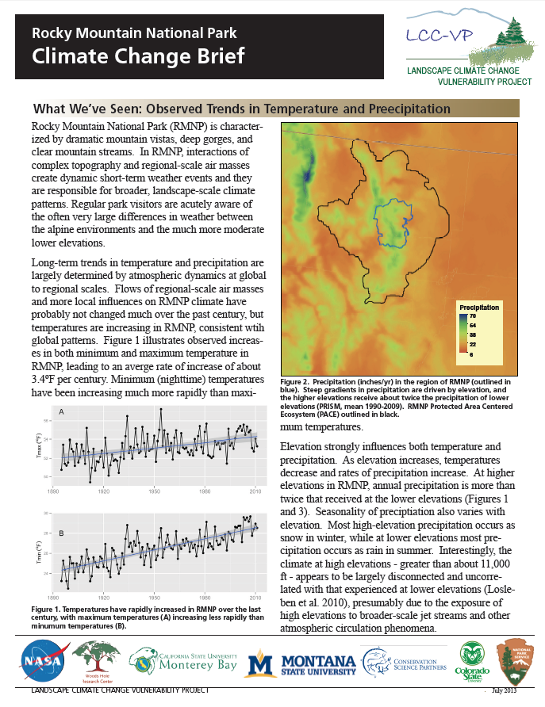
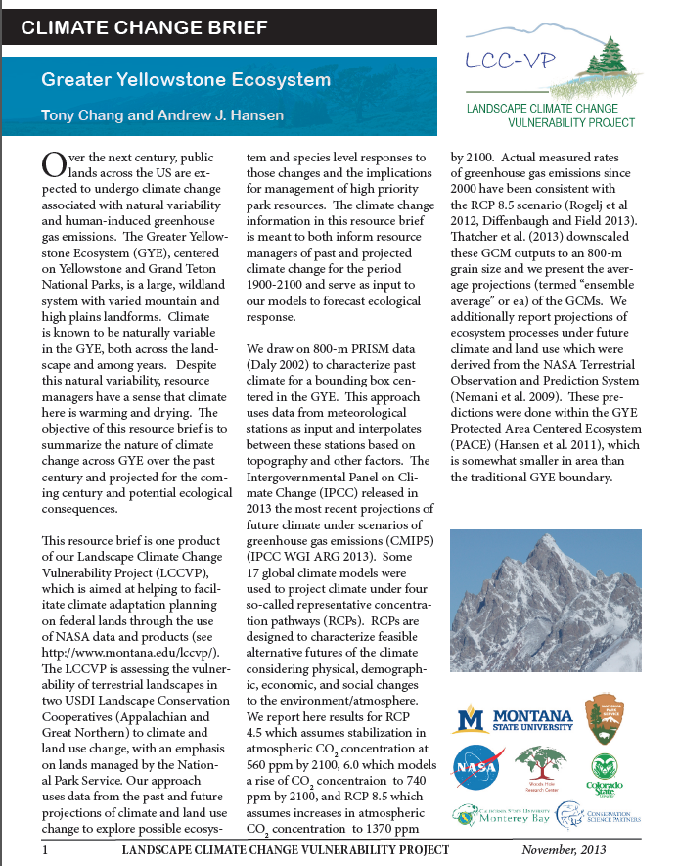
Lessons Learned
Communicate results in a management-relevant context

Slide 9
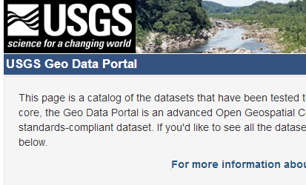
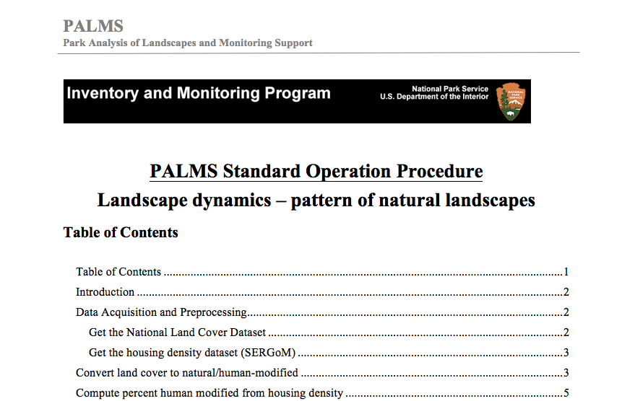
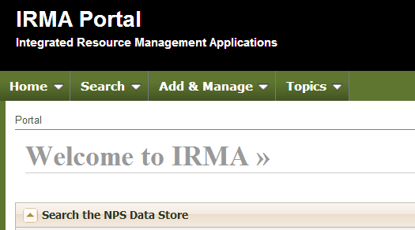
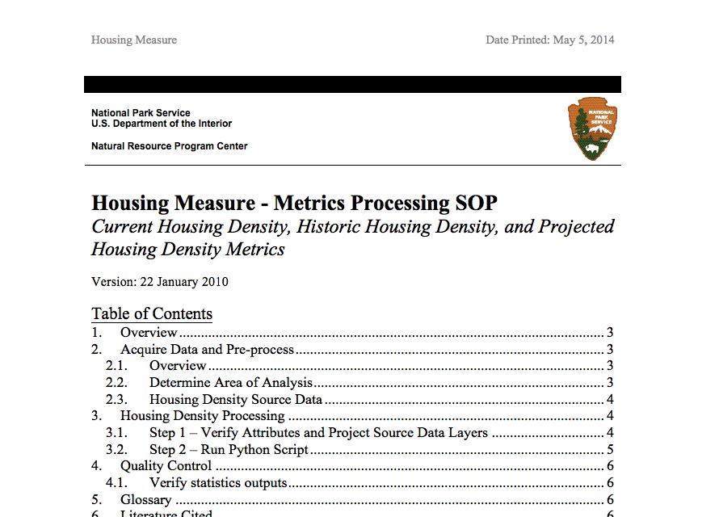
Lessons Learned
Conform or embellish existing frameworks and processes
Plan for persistence and change
9

Slide 10
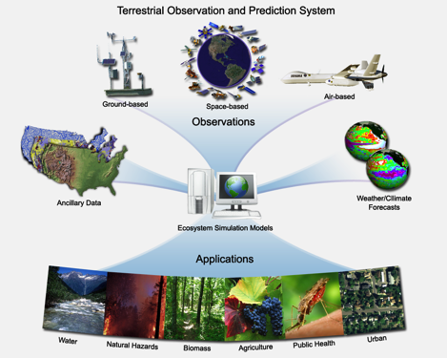
Lessons Learned
Build on existing data analysis tools and software frameworks.
VisTrails SAHM
NASA TOPS

Slide 11
Conclusion
The USGS Resource for Advanced Modeling (RAM) has been greatly enhanced by support from the NASA Biodiversity Program.
The RAM has moved into an operational capacity, serving primarily the Department of Interior and a key component in the North Central Climate Science Center’s science delivery strategy.
Machine Services will provide a new and exciting tool for high-speed habitat modeling.

